Slide 1





CISC3003-Team08
Individual Project
Walkthrough
DC126711 HUI GUANHAO

Slide 2
CONTENTS
01
04
Abstract
Accomplish
02
Services
05
Incomplete
03
06
Walkthrough
Tasks

Slide 3
Abstract
This project aims to develop a full-stack web for the profile interface of the MRP system. The system will provide a user-friendly interface, namely responsive web design, for both PC users and mobile device users. For front-end development, we will use HTML, CSS and JavaScript in order to implement multiple features. The back end uses PHP to manage web pages. The backend is responsible for responding to client requests such as updating username, phone and email, etc. And use MySQL to save the data required by customers. It also includes account logout, upper navigation bar and other features. In short, this project implements the personal data interface system by combining front-end and back-end to achieve an efficient and user-friendly website.

Slide 4
Services
User Authentication Service
Database Query Service
User Information Display Service
User Information Editing Service:
Verifies if the user is logged in using PHP's session mechanism.
Connects to the database using PHP and retrieves user information based on the logged-in user's username.
Displays the user's profile information on the page, including profile picture, username, gender, phone number, email, and address, based on the retrieved user information.
Provides user information editing functionality through a form, allowing users to modify their profile information.

Slide 5
Services
User Logout Service
Offers a logout link that users can click to clear the session and return to the login page.

Slide 6

Tasks
Start the PHP session.
Include the database connection file.
Query the information of the currently logged-in user.
If the query result is empty, display an error message.
Display the webpage header, including the logo, navigation bar, and user avatar.

Slide 7
Tasks
Display the user information section, including the user avatar, username, switch account, and logout links.
Display the profile editing form, including fields for uploading a profile picture, username, gender, phone number, email, and address.
If the user is logged in, display the user's personal information; otherwise, display default information.
When the form is submitted, send the form data to a PHP file for processing.
When the user clicks the logout link, clear the session and redirect to the login page.

Slide 8
Accomplishments
This profile page project demonstrates the developer's strong skills in web development, including front-end design, back-end programming, database management, and user authentication. The developer implemented a responsive design to ensure an optimal viewing experience across various devices and screen sizes. Moreover, the developer employed data validation and performance optimization techniques, showcasing their attention to detail and commitment to delivering a high-quality user experience. Additionally, the developer collaborated with the team to seamlessly integrate the profile page into the overall application, maintaining consistency in design and functionality. Overall, this project highlights the developer's ability and professionalism in building secure, dynamic, and user-friendly web applications.

Slide 9
Incomplete
Despite the significant progress made in the profile page project, there are still areas that require further development. The current implementation lacks essential features such as password change functionality, real-time form validation, and comprehensive testing. Moreover, enhancements are needed to optimize profile picture compression, improve mobile responsiveness, and address accessibility considerations. Integrating the profile page with a user notification system would keep users informed about important updates. While basic testing has been conducted, more thorough testing is necessary to identify and resolve potential issues across different browsers and devices. Addressing these incomplete tasks and features will elevate the functionality, usability, and overall quality of the profile page project, resulting in a more polished and feature-rich user experience.

Slide 10
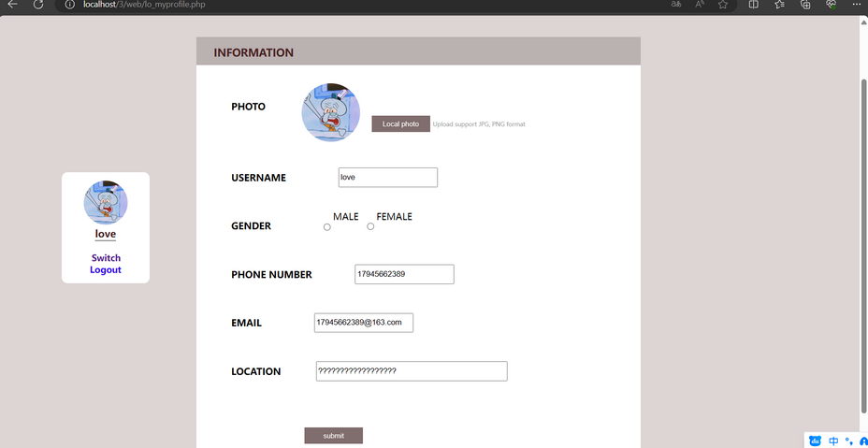
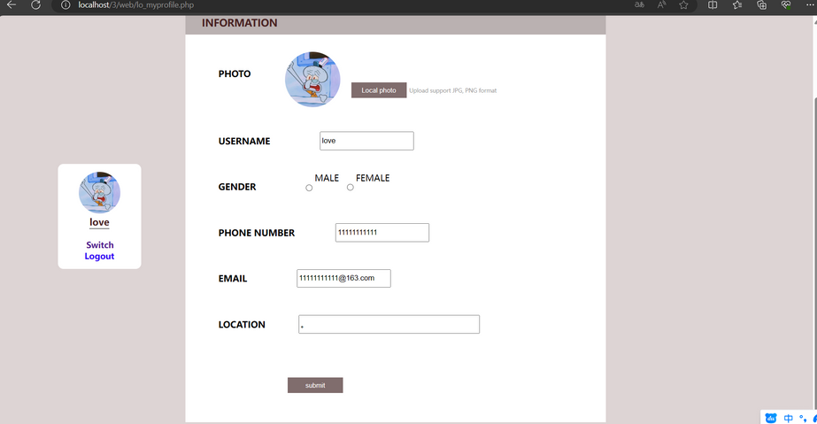
Workthrough

Slide 11
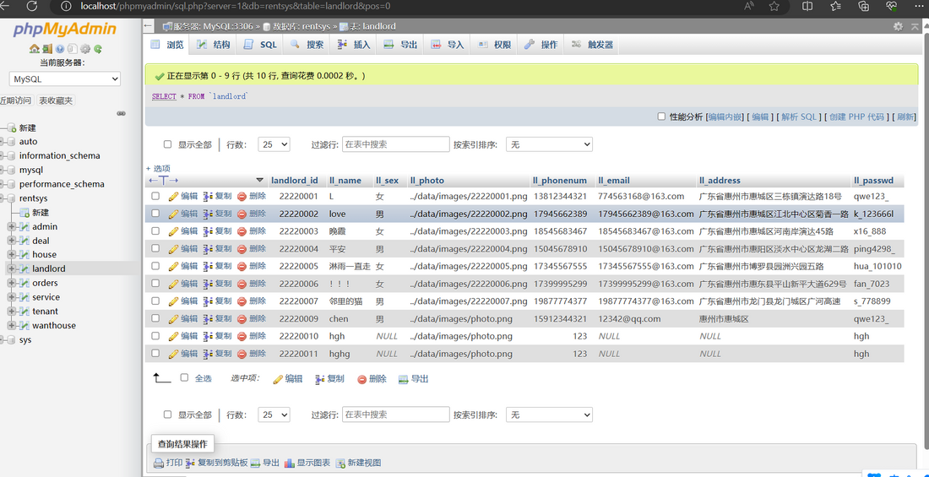
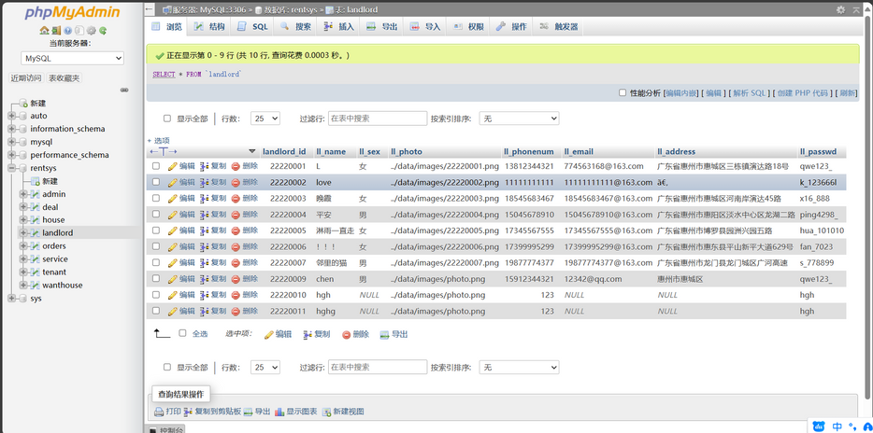
Workthrough

Slide 12
CISC3003 INDIVIDUAL PROJECT WALKTHROUGH
THANK YOU
DC126711 HUI GUANHAO

